Slide 1
Employment and Monetary Policy: The Role of Relative Price Distortions
Economics Colloquium
Lawrence University
October 3, 2013
Merton Finkler, Ph.D
Professor of Economics

Slide 2
Money: Setting the Mood
Money: “anything which is widely accepted in payment for goods or in discharge of other kinds of business obligations.” – D. Robertson
Money: “a blessing that is of no advantage to us excepting when we part with it. An evidence of culture and a passport to polite society. – The Devil’s Dictionary, A. Bierce
“Cheap money can’t buy a strong economy” – R. Samuelson

Slide 3

The Money Trap

Slide 4
Happy Centennial

Slide 5
Overview
Motivation for the Paper
The Literature and the Dual Mandate
Specification and Data Sources
Results
Discussion of Results
Implications and Conclusions

Slide 6
Motivations
Employment Trends
  Disconnect between Employment Growth and GDP growth
  Relative prices and substitution of capital for labor
  Employment population ratio
Model for Senior Experience Research Projects

Slide 7
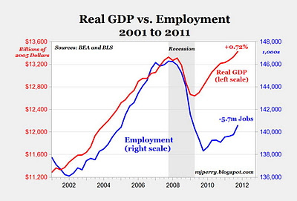

Slide 9
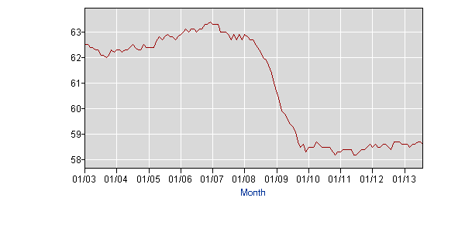
Employment/ Population Ratio

Slide 10
Background and Literature
  The Dual Mandate as stated by the 1977 Congressional amendment to the Federal Reserve Act
  “The Board of Governors of the Federal Reserve System and the Federal Open Market Committee shall maintain long run monetary policy and credit aggregates commensurate with the economy’s long run potential to increase production, so as to promote effectively the goals of maximum employment, stable prices and moderate long term interest rates”
“The maximum level of employment is largely determined by nonmonetary factors that affect the structure and dynamics of the labor market” – Statement of Principles – 1/25/12 – Federal Reserve Bank of Chicago

Slide 11
Literature (continued)
Many papers related to Okun’s Law, – Knotek (KC Fed – 2007 and 2009)
Production function literature – Chirinko (2008) on elasticity of substitution between capital and labor
Competitive equilibrium in capital markets forces MPK to align with real interest rates; thus either capital must increase or employment must decline – Gavin (2013)
Dynamics of employment and unemployment – Shimer (2012)
None directly relate monetary policy to changes in employment

Slide 12
Targets for Specification
Kocherlakota (2012): Both labor demand and product demand should be central to macroeconomic stabilization policy
Chirinko (2008) – Attempts to estimate the short run elasticity of substitution between capital and labor (in response to their prices) are fraught with measurement problems→ disaggregate

Slide 13
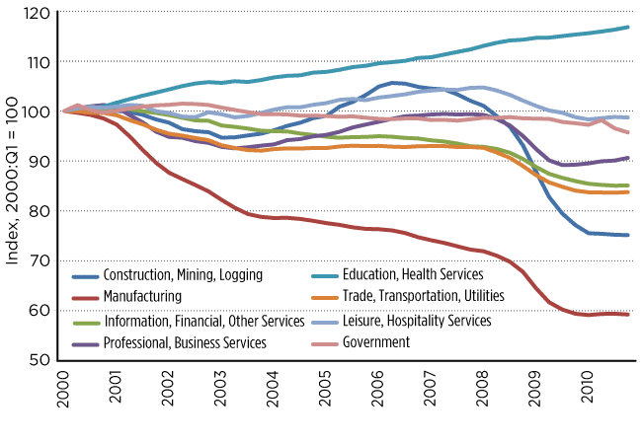
Indices of Employment by Sector

Slide 14
Research Question
How are changes in employment related specifically to product demand and labor demand components for specific sectors of the economy?
  Product demand includes both direct and indirect indicators
  Labor demand incorporates substitution between labor and capital based on relative factor prices

Slide 15
Specification to be Estimated
Net Job Gains_{it} = constant + α*(Price of Labor_{it}) + β*(Price of Capital_{t}) +γ*(Value Added_{it}) + δ*(Borrowing Rate_{t}) + θ*(Price of Capital_{t}*Borrowing Rate_{t}) + μ*(Fedfunds_{t}) + ε_{it}
where i stands for the industry in question and t reflects the specific time period.
Separate estimates for changes in employment in private goods production, service production, & manufacturing employment
Specification based on cost of adjustment idea
Tried various lag structures without much change
Regression based on data from Q3:1992 to Q4:2007

Slide 16
Data Sources
Employment changes taken from the Business Employment Dynamics Survey , not monthly household or payroll surveys (all BLS surveys)
Quarterly series begun in Q3:1992 and represents 98% of employment on private, non-farm payrolls
BEA provides quarterly price index for equipment and software
BLS provides monthly labor compensation and unit labor cost data – middle month selected
BEA calculates value added by industry on an annual basis – smoothed to include quarterly entries
Moody’s interest rate on bonds rated Baa (available daily, used middle month) – to represent borrowing rate
Fed funds rate – middle month selected

Slide 17
Table 1 Goods Producing Sector
Dependent Variable: G_NJOBCH | (1) | (2) | (3)
Glaborcost | -46.7 (9.82)** |  | -75.9 (12.9)**
Gvalueadded | 1.07 (.223)** | .061 (.193) | 2.31 (.405)**
Esoftpi | -92.9 (30.0)** | -16.1 (28.3) | -44.5 (28.1)
Moodys_Baa | -1409 (381)** | -533 (362) | -777 (348)*
Capcost | 11.8 (3.5)** | 4.10 (3.17) | 6.60 (3.17)*
Fedfunds |  | 8.29 (13.6) | -75.4 (19.6)**
Constant | 12,673 (3,664)** | 2,197 (3,479) | 7,127 (3,375)*
Observations | 62 | 62 | 62
Adjusted R² | .587 | .400 | .686
* statistically significant the 5% level, ** statistically significant at the 1%

Slide 18
Goods Producing Sector
Goods production accounts for about 17% of private non-farm employment and 21% of private non-farm value added
A 1% increase in value added → an employment increase of 65k jobs (Goods value added = $2.8Tr)
A 1 percentage point increase in labor cost → a decline of 76k jobs (Index at 110 in 2009)
  If the labor cost related terms is dropped, the R² drops from .69 to .40 (column 2)
  If the Fed funds term is dropped from the equation, R² drops from .69 to .59 (column1)

Slide 19
Table 2 Service Producing Sectors
Dependent Variable: S_NJOBCH | (1) | (2) | (3)
Slaborcost | -183 (48.1)** |  | -218 (71.2)**
Svalueadded | 1.24 (.335)** | -.141 (.069)* | 1.54 (.540)**
Esoftpi | -110.5 (61.7) | -85.9 (55.93) | -91.3 (60.6)
Moodys_Baa | -1695 (796)* | -1444 (719)* | -1463 (777)
Capcost | 13.4 (7.18) | 11.2 (6.43) | 11.4 (7.05)
Fedfunds |  | 62.5 (22.3)* | -29.0 (34.6)
Constant | 21,178 (8,203)** | 12,072 (6,462) | 20,056 (7966)**
Observations | 62 | 62 | 62
Adjusted R² | .414 | .305 | .420
* statistically significant the 5% level, ** statistically significant at the 1%

Slide 20
Service Producing Sector
Service production accounts for about 83% of private non-farm employment & 79% of private non-farm value added
A 1% increase in value added → an employment ↑ of 160k jobs (Service value added = $10.4Tr)
A 1 percentage point increase in labor cost → a decline of 218 k jobs
If the labor cost related term is dropped, R² drops from .42 to .31 (column 2)
  If the Fed funds term is dropped from the equation, R² drops from .420 to .414 (column1)

Slide 21
Manufacturing
Manufacturing accounts for about 11% of private non-farm employment and 13% of private non-farm value added
The cost of labor matters here as well, but productivity increases have been significant
Decision-making is based on the ratio of the two indicators to obtain the unit labor cost = cost of labor/productivity of labor

Slide 22
Unit Labor Cost

Slide 23
Table 3 Manufacturing Sector
Dependent Variable: M_NJOBCH | (1) | (2) | (3)
ULC_M | -34.2 (6.77)** |  | -31.5 (6.41)**
Mvalueadded | 1.07 (.180)** | .920 (.242)** | 1.33 (.245)**
Esoftpi | -33.6 (13.0)** | 20.4 (14.8) | -12.0 (14.7)
Moodys_Baa | -506 (168)** | 14.1 (188) | -244 (184)
Capcost | 4.43 (1.54)** | -.108 (1.66) | 2.23 (1.65)
Fedfunds |  | -33.0 (13.1)** | -20.8 (10.6)**
Constant | 5,494 (1,685)** | -3,446 (1,860) | 2,462 (1,915)
Observations | 62 | 62 | 62
Adjusted R² | .660 | .549 | .678
* statistically significant the 5% level, ** statistically significant at the 1%

Slide 24
Manufacturing Sector
A 1% increase in value added → an employment increase of 23k jobs (Manufacturing value added = $1.7Tr)
A 1 percentage point increase in unit labor cost → a decline of 32 k jobs
  If the labor cost related terms is dropped, R² drops from .68 to .55 (column 2)
  If the Fed funds term is dropped from the equation R² , drops from .68 to .66 (column1)

Slide 25
The decline in employment in the goods production sector during ‘08-’09 recession ≈ equal to that for the service production sector despite much lower share of overall employment.

Slide 26
Discussion of Results
Comparison of restricted with the unrestricted model for Q4 2007 – Q2 2011 shows that unrestricted performs better than one without labor cost considerations.
Results are consistent with Congressional Research Office report by Levine (2013), which suggests that 20 to 50% of the rise in unemployment between 2007 and 2010 was structural – not related to search or cyclical forces.

Slide 27
Net Jobs Change and Predicted Net Jobs Change – Goods Producing

Slide 28
Net Jobs Change and Predicted Net Jobs Change – Service Producing

Slide 29
Net Jobs Change and Predicted Net Jobs Change – Manufacturing

Slide 30
Implications
A stable relationship between GDP growth and employment growth depends upon a stable relationship between the cost of labor and the cost of capital.
The most recent business cycle featured significant changes in factor prices.
Aggressive monetary policy along with uncertainty regarding the prospective cost of labor provided reasons to substitute capital (especially equipment and software) for labor.

Slide 31
More Implications
A sustained very low or negative real interest rate: interest rate - Expected(inflation) < 0 - distorts decision-making
Decisions affected include
  Saving vs. Borrowing
  Portfolio and Pension Management
  Domestic vs. International Capital Flows
  Labor vs. Leisure (including retirement)
  Allocation of Employment Across Sectors

Slide 32
Conclusions
The Federal Reserve’s policy statement (12/12/12) basing monetary policy on rates of unemployment is not the best way to satisfy the maximum employment criterion.
Policies to increase employment should be focused on reducing the relative price of labor and such policies are beyond the options available to the Fed.
Financial repression, especially if real rates of interest are negative for a long time, distorts decision-making.
Similar to any system, dependence on one lever of influence is unhealthy.

Slide 33

What Do We Do Now?

